Slide 1
If banning politics is the answer, ask a different question…
How can organizations engage with activists and activism?
July 2021

Slide 2









Who’s knocking…

Slide 3
A Reitz/Higgins research study begun in 2014 into ‘Speaking truth to power’
July 2019: FT Pearson/FT Publishing ‘Speak up: Say what needs to be said and hear what needs to be heard’
Harvard Business Review 2017-21
Do you have advantage blindness? (with Ben Fuchs)
The problem with saying my door is always open
5 questions to ask before you call out someone more powerful
You’re scarier than you think
The wrong way to respond to employee activism (with Emma Day-Duro)
Don’t ban politics at work
Hult Ashridge Research Reports 2017, 2019 and 2021
Being silenced and silencing others: Developing the capacity to speak truth to power
Speaking truth to power: Interim survey results into how people are silenced and silence others at work
The do’s and don’ts of employee activism
British Medical Journal Leader (2020) Speaking truth to power: Why leaders cannot hear what they need to hear & Journal of Royal Society Medicine (2019) If whistleblowing is the answer: find a better question
Sloan Management Review (Winter 2021) Leading in an age of employee activism

Slide 4
What words come to mind when you think of activism
and activists?

Slide 5
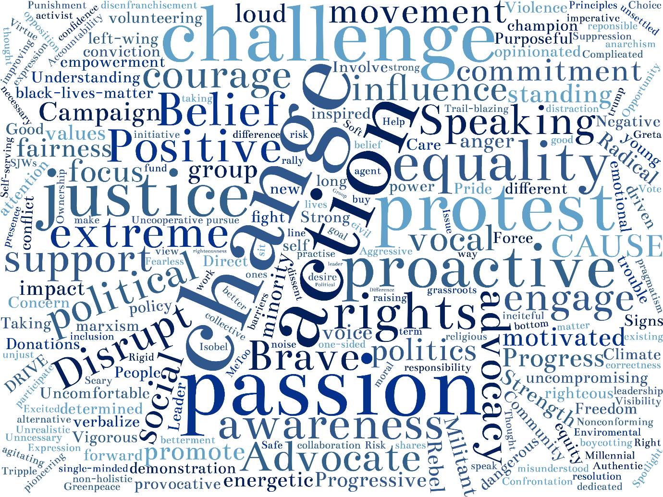
Source: Reitz & Higgins 2021

Slide 6
Emotional Passionate, strong feelings, drive
Committed Cares, believes, takes action
Political Revolutionary, radical, social justice
Courageous/Tenacious Brave, independent, visible
Arrogant Opinionated, out-of-touch, busy-bodies
Disruptive Non-conformist, challengers, trouble-makers
Attention seeking Self-publicity, virtue signalling, going along for the ride
Irrelevant Ignored, hippy, misfit
Engaging Changemaker, belief spreader, empowering
Activism is in the eye of the beholder
Source: Reitz & Higgins 2021

Slide 7
Exploring personal and organizational responses to emerging activist agendas
A definition… voices of difference that challenge the established status quo as to who gets heard and/or what should be included in the formal organizational agenda
What follows:
A framework for assessing a range of responses
A framework for exploring what triggers of smothers a response (ACTIF)
Source: Reitz & Higgins 2021

Slide 8
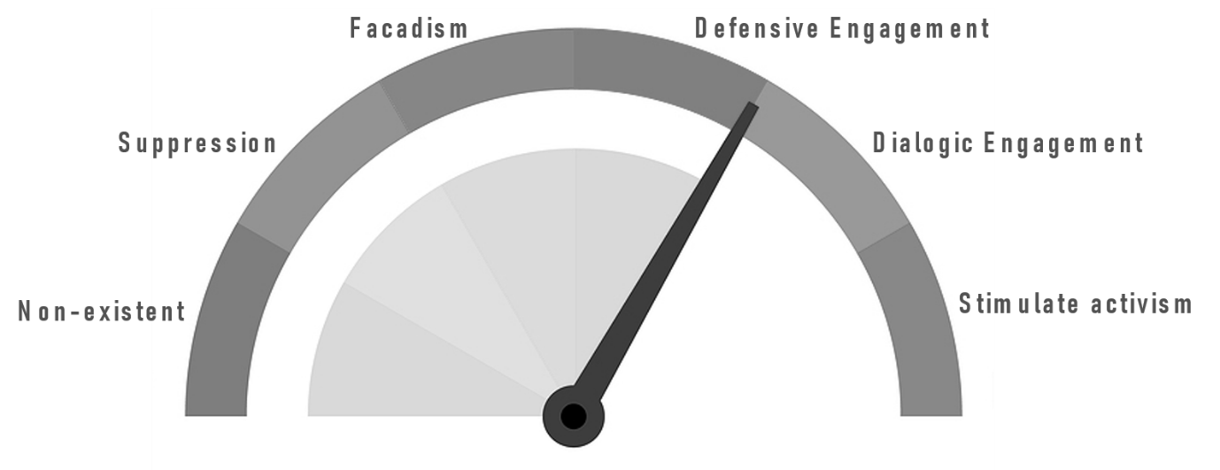
How you respond depends on where you (REALLY) are and what your intentions are
Source: Reitz & Higgins 2021

Slide 9
Response to employee ‘activism’ is in the eye of the beholder
Reactive
Proactive
Reitz, M. and Higgins, J. (2021)

Slide 10

Leaders can get stuck in an ‘optimism bubble’
Advantage blindness
Superiority illusion
Source: Reitz & Higgins 2021

Slide 11
How you see things depends on where you stand

Slide 12
The ACTIF model for understanding activism and ‘banning politics’
Authority
Power Over
Power With
Concern
Less Energy
More Energy
Theory of Change
Independent
Interdependent
Identity
Rule Taker
Rule Maker
Field
Less Prominent
More Prominent
Source: Reitz & Higgins 2021

Slide 13
Headline recommendations from our latest HBR piece…
Build empathy and respect for others
Invite different perspectives into the leadership fold
Accept mistakes gracefully
Teach people how to disagree
Source: Reitz & Higgins 2021

Slide 14

Build empathy and respect for others…
“Persons appear by entering into relation to other persons”

Slide 15
Build empathy and respect for others… what makes it tricky
Wider social context….
- Polarization… echo chambers… heroic individualism
Internal narratives…
- Our little list… high regard for own opinion
Standardization and homogeneity
- Recruit and promote for sameness
Alignment and common purpose
- What gets lost in the shadow of a ‘laser focus’?
Workplace insecurity
- Anxiety… upheaval… opposite of psychological safety
Source: Reitz & Higgins 2021

Slide 16

Invite different perspectives into the leadership fold…
We invite people in for their difference – and then keep them for their sameness
Based on work of KK Smith & DN Berg, Human Relations 1987

Slide 17
Invite different perspectives into the leadership fold… the bumps in the road
Don’t rush to action
- News of difference is unsettling… the default of busyness
Seek to understand message and messenger
- Activism part of personal identity... not used to being heard well or speaking to be heard
Don’t insist on a business case from the start
- The language of the insider… clash of intrinsic and extrinsic values
Expect to feel uncomfortable and inexpert
- Defensiveness and shame
This will take time
- Clock time versus heart time
Source: Reitz & Higgins 2021

Slide 18
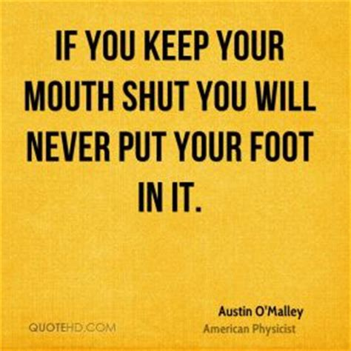

Accept mistakes gracefully…

Slide 19
Accept mistakes gracefully… we are human, all too human
Everyone will put their foot in it
- Fail better (Samuel Beckett)
Assumptions in action will reveal biases and ignorance
Zero tolerance creates spirals of silence
Find points of connection
- Common humanity
- Family… food… fiascos
Source: Reitz & Higgins 2021

Slide 20

Teach people how to disagree…
Source: Reitz & Higgins 2021

Slide 21
Teach people how to disagree…
Senior people (re)learning how to be challenged
- More inquiry, less advocacy
- Start with orientation to the other
- Little conversations first
Don’t mistake espoused for actual skills
- Catch yourself in the moment
Set up peer and cross-sectional Action Learning Sets
Work with current reality
- Change by moving into the adjacent space
Know yourselves
- Meta-cognition (AIM)
Source: Reitz & Higgins 2021

Slide 22
A Summary
Activism is about conversational patterns – who gets heard? Who listens? About what?
Activism is in the eye of the beholder
Activism is about voices of difference that challenge the status quo (so its all about POWER)
Senior people see more positive response to activism in their organization than junior people
The ACTIF framework helps get to grips with a very slippery topic
Source: Reitz & Higgins 2021

Slide 23
How you respond depends on where you (REALLY) are and what your intentions are
Source: Reitz & Higgins 2021

